Slide 1
SmartHouse
QOL - Quality Of Life

Slide 2
Outline
Intro
System Overview
OCD
SSS
Data Flow and State Diagrams
STD
Conclusion

Slide 3
Intro - Old System
No voice commands
  No way to have your house immediately apply to your needs
No personal profile
  No way to store personal preferences or privileges to comfort your every day life
No personal schedule
  No way to have your house guide you through the day

Slide 4
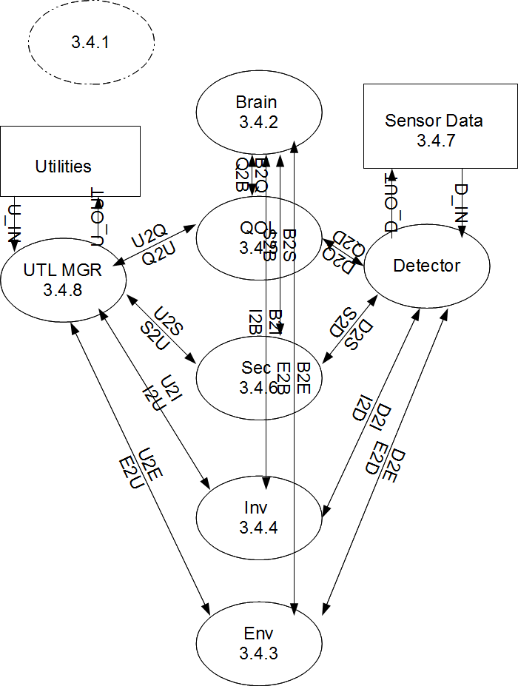
SmartHouse
DFD-3.4

Slide 5
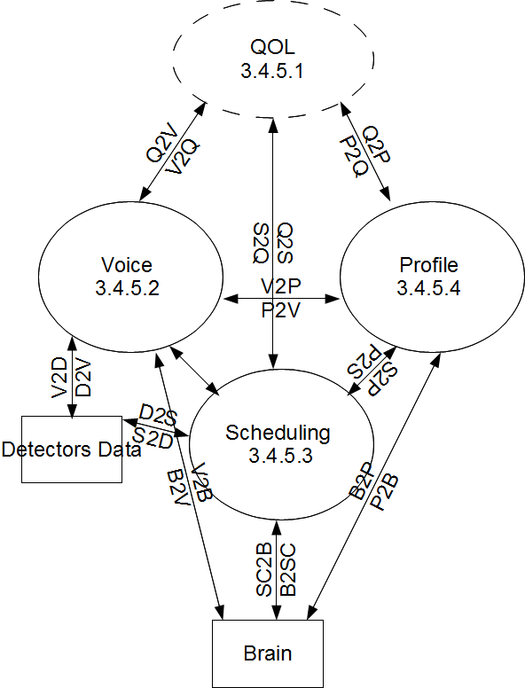
Qualitiy of Life
DFD-3.4.5

Slide 6
OCD-Voice
New features
  Communicate with your house
  Various languages to chose from
  No remote necessary
  Customized commands
  Customized sound levels

Slide 7
OCD-Schedule
New features
  Automatic and custom lighting schemes based on user's schedules
  Automatic and custom climate control based on user's schedule
  Home automation based on away and occupied states.

Slide 8
OCD-Profile
New Features
  Store Preferred Music and Artwork
  Capability to recognize YOUR voice
  Interact with external sound systems and displays
  Separate privileges for guests/kids/owners
  Default settings for new users

Slide 9
SSS-Voice
Requirement 3.3.1.1 :Syntax
Synopsis:
The system shall provide a pre-defined syntax to the user for communication.
Specifics:
The system’s syntax for a voice command shall have two components KEYWORD + CONTENT.

Slide 10
SSS-Schedule
Requirement: 3.4.5.3.3 Light Controller
  Synopsis:The system will work with the scheduling and turn lights on and off according to arrival and departure schedule
  Specifics: The house will always be lit when someone is home or about to come home and when they leave the lights will be turned off to save electricity.

Slide 11
SSS-Profile
Requirement 3.3.1.8: Privilege Profile Settings
Synopsis: The system shall have a privilege system to authorize commands and determine precedence
Specifics: A user with higher privileges has higher precedence, and preferred artwork takes priority.
Certain privilege levels will be restricted as to what they can change in the system settings.

Slide 12
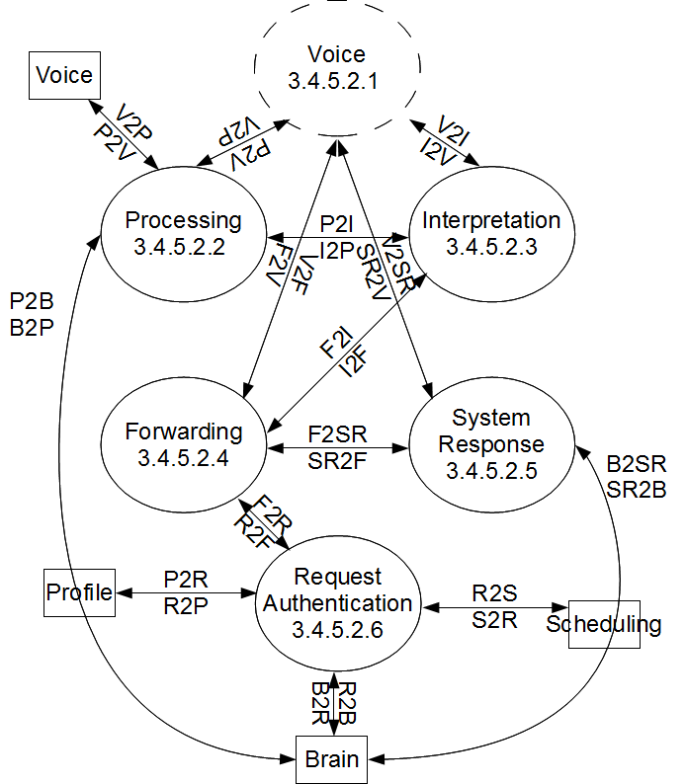
Diagrams-Voice
DFD-3.4.5.2

Slide 13
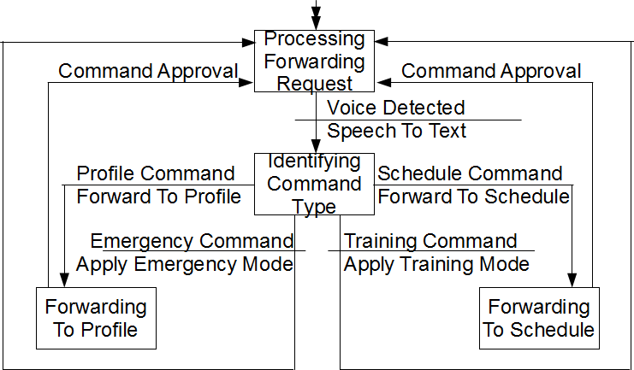
Diagrams-Voice
DFD-3.4.5.2.4.1

Slide 14
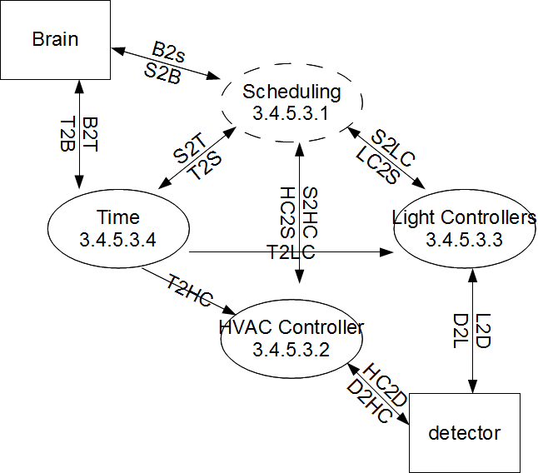
Diagrams-Schedule
DFD-3.4.5.3

Slide 15
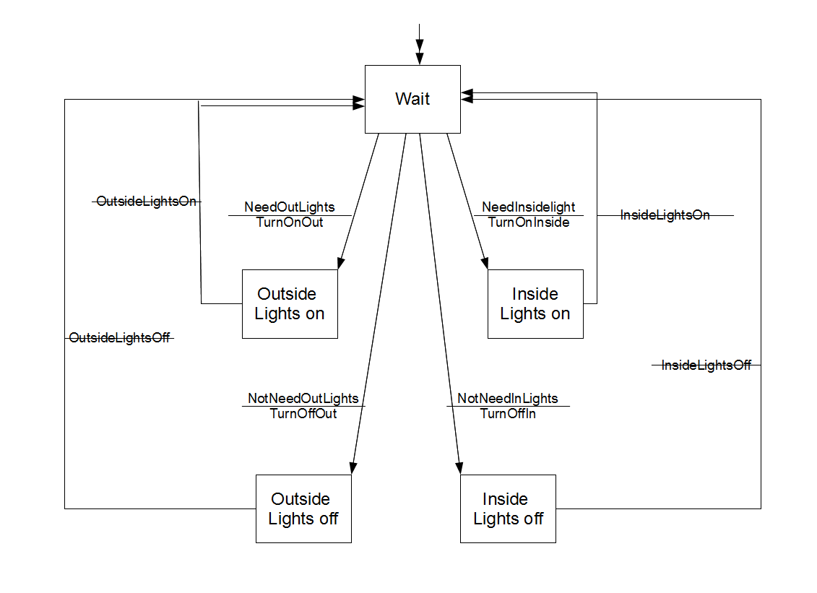
Diagrams-Schedule
STD
3.4.5.3.3.1

Slide 16
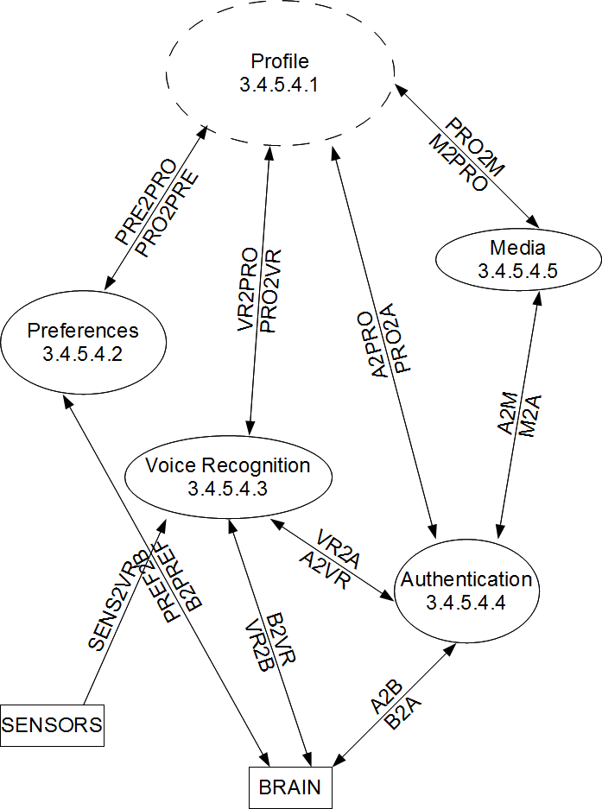
Diagrams Profile
DFD-3.4.5.4

Slide 17
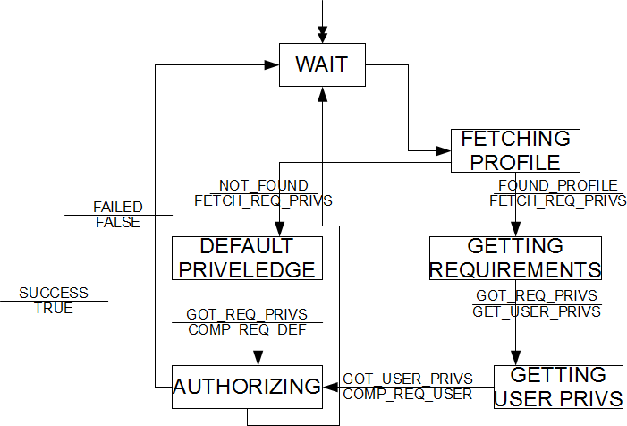
Diagrams Profile
STD-3.4.5.4.4

Slide 18
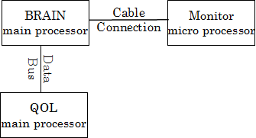
STD-Voice
Intruder Detection Part 1

Slide 19
STD-Voice
Intruder Detection Part 1
  Condition:
    Normal mode + unoccupied state
  Input:
    Intruder applies the command “turn off the alarm”
  Expected result:
    The system shall not pass on to password request and deny the command instantly based on the intruder's unauthorized status

Slide 20
STD-Schedule
Light Controllers
  Condition
    The house is in normal mode and schedule says the home owner will be coming home soon
  Input
    It is dark outside and lights should be turned on
  Result
    The inside and outside lights should be on

Slide 21
STD-Profile
Preferred Artwork Display
  Condition:
    normal mode + unoccupied state
    Display is off, system is set up for only one room with one screen.
  Input:
    User with stored artwork display preferences enters the SmartHouse
  Expected result:
    The system shall power on the display, then show the user's preferred artwork from the user's profile on the display.

Slide 22
Conclusion
Key feature voice commands
  Very efficient command system
  Enhancing your own safety
Key feature personal profile
  Enhanced home atmosphere with automated dynamic display/sound system
  Store preferences for everyone, even guests
Key feature personal schedule
  Automatic lights based on scheduling
  Automatic climate control based on scheduling

